Slide 1


SCHOOL MANAGEMENT SYSTEM
SUPERVISOR Mr.A.Malarmannan,M.E.,, AP/CSE.
PRESENTED BY
2303811710421148 – SIBI RAJ .A

Slide 2

PRESENTATION OVERVIEW
Objective
Project Introduction
Problem Statement
Methodologies (Programming concepts relevant to problem statement)
Architecture of the proposed system
List of Modules
Merits
Results and Discussion
Queries

Slide 3
OBJECTIVE
The primary objective of the project is to record and manage student personal details such as, (name, age, address, etc.), for maintaining the teacher profiles namely, (name, qualifications, contact details), to create, monitor, and manage courses for the students in the school, for generating and managing class schedules for students and teachers, and record student grades for exams and assignments and generate reports.

Slide 4
PROJECT INTRODUCTION
A School Management System (SMS) is a software solution designed to streamline and automate various administrative tasks within a school, ensuring efficiency, accuracy, and better management of resources. The system typically manages student information, attendance, grades, timetables, fee structures, library resources, and communication between students, teachers, and administrators. In Java, the School Management System can be developed using core Java concepts, object-oriented programming principles.

Slide 5
PROBLEM STATEMENT
Managing records and data using traditional methods, such as physical registers or paper-based systems, is inefficient, time-consuming, and environmentally unfriendly. There is a need for a centralized, user-friendly, and real-time digital system to streamline the creation, update, and dissemination of details while ensuring accessibility and reducing manual effort.

Slide 6
METHODOLOGIES (PROGRAMMING CONCEPTS RELEVANT TO PROBLEM STATEMENT)
Object - Oriented Programming (OOP) : You'll create classes to represent entities like Student, Teacher, Course, ClassRoom, etc.
Control Flow Statement : Loops are used to iterate over collections like lists of students or teachers.
Exception Handling : Try-catch blocks: Exception handling helps to deal with runtime errors such as invalid input, missing files, or database connection errors.
File (I/O) (Input/Output) : Saving student data, grades, or class schedules to a file or reading data from a file.
GUI (Graphical User Interface) : Used to provide a user-friendly interface, to create windows, buttons, tables, forms, and other UI components.

Slide 7
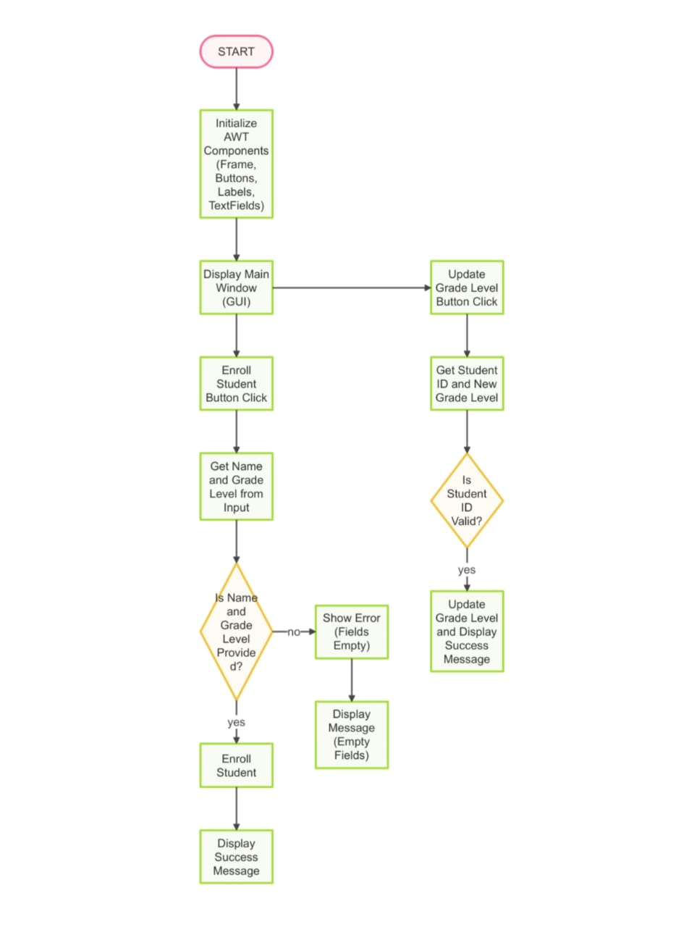
FLOW DIAGRAM

Slide 8
MODULE DESCRIPTION
1. Student Management Module :
The Student Management module is the core of a School Management System, responsible for maintaining a comprehensive database of all student information. This includes personal details such as name, address, date of birth, and contact information.
2. Staff Management Module :
The Staff Management module is designed to handle all aspects of teacher administration. It stores essential teacher information, including personal details, qualifications, subjects taught, work schedule, and salary information.

Slide 9
MODULE DESCRIPTION
3. Course Management Module :
The Course and Subject Management module helps in organizing and structuring academic courses and classrooms. It allows the creation of various classes, courses, and subjects offered by the school.
4. Grades and Examination Module :
The Grade and Examination Management module is integral for managing academic assessments. It handles the creation, scheduling, and grading of exams, both internal (midterms, quizzes) and external (final exams, standardized tests).

Slide 10
MERITS
Instant Updates - Deatils can be updated in real-time for everyone to see immediately.
Paperless System - Saves paper, making it eco-friendly and cost-effective.
Easy to Use - A simple interface makes managing and viewing records hassle free.
Accessible Anywhere - Details can be viewed on different devices anytime.
Organized Display - Records are sorted into categories for better readability.
Customizable and Scalable - Can be adjusted to suit the needs of more users.

Slide 11
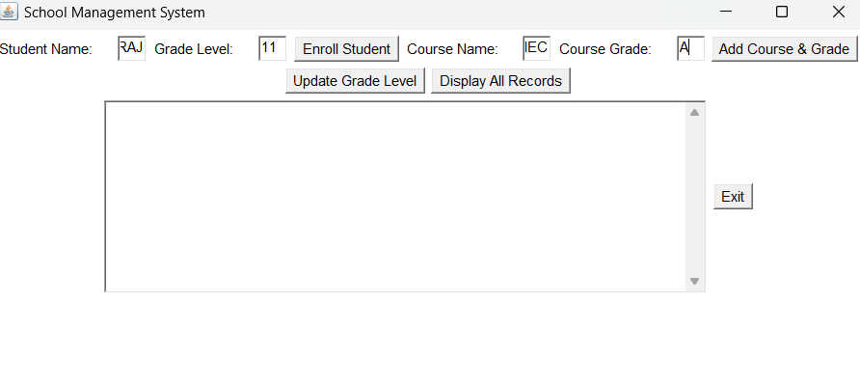
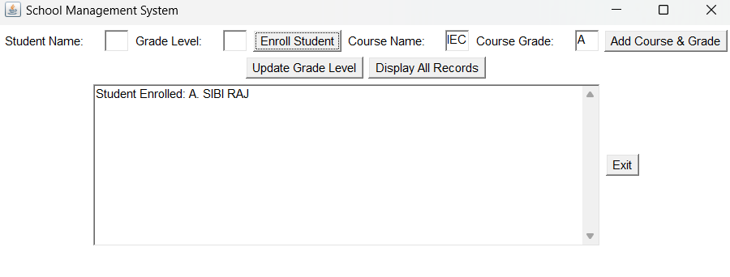
RESULT AND DISCUSSION

Slide 12
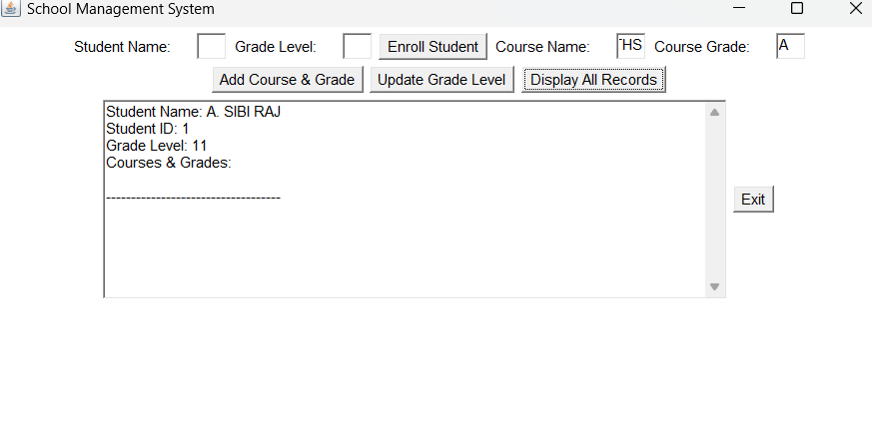
RESULT AND DISCUSSION

Slide 13
THANK YOU

